Slide 1
Lesson01- Introduction To Kubernetes

Slide 2
Lesson Objectives
Case Study For Kubernetes
Deployment With Kubernetes
How does Kubernetes Work
Need Of Kubernetes
Kubernetes What and Why
What Is Kubernetes
Container Orchestration
Notes:
Add instructor notes here.

Slide 3
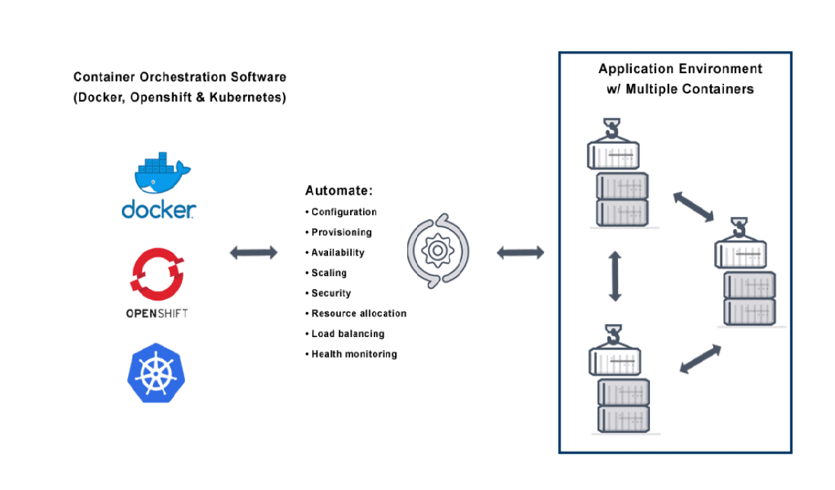
Container Orchestration
Notes:
Container orchestration works with tools like Kubernetes and Docker Swarm.
Configurations files tell the container orchestration tool how to network between containers and where to store logs.
The orchestration tool also schedules deployment of containers into clusters and determines the best host for the container.
After a host is decided, the orchestration tool manages the lifecycle of the container based on predetermined specifications.
Container orchestration tools work in any environment that runs containers.

Slide 4
What is Container Orchestration
Container orchestration is the automation of all aspects of coordinating and managing containers.
Container orchestration is focused on managing the life cycle of container.
Container orchestration manage the dynamic environments.
Notes:
Benefits of Containerized Orchestration Tools
• Increased portability — Scale applications with a single command and only scale specific functions without affecting the entire application. • Simple and fast deployment — Quickly create new containerized applications to address growing traffic. • Enhanced productivity — Simplified installation process and decreased dependency errors. • Improved security — Share specific resources without risking internal or external security.
Application isolation improves web application security by separating each application’s process into different containers.

Slide 5
Why Need Container Orchestration?.
Configuring and scheduling of containers
Provisioning and deployments of containers
Availability of containers
The configuration of applications in terms of the containers that they run in.
Scaling of containers to equally balance application workloads across infrastructure
Allocation of resources between containers
Load balancing, traffic routing and service discovery of containers
Health monitoring of containers
Securing the interactions between containers.
Notes:
Orchestration tools for Kubernetes include the following features: • Automated deployment and replication of containers. • Online scale-in or scale-out of container clusters. • Load balancing groups of containers. • Automated rescheduling of failed containers. • Controlled exposure of network ports to systems outside of the cluster.

Slide 6
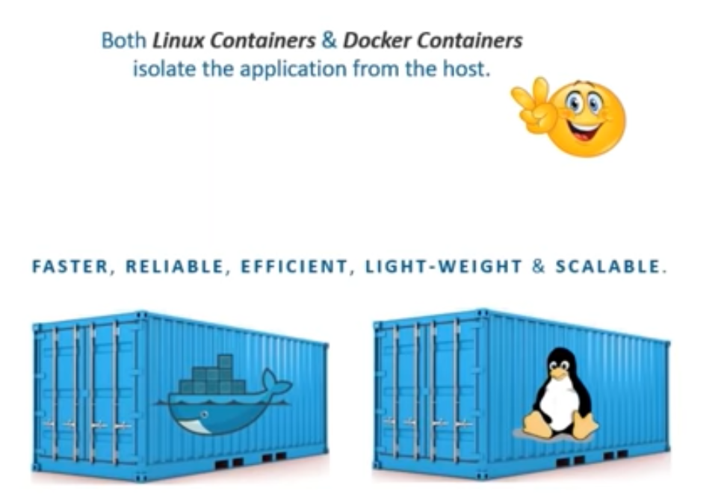
What is Kubernetes and What is the Need of It.
Kubernetes is not the containerization platform like Docker.
Any container like Rocket, Docker, Linux are good which package the application and isolate it from host.
This makes container fast, reliable ,scalable. efficient But even if containers are scalable they are not easily scalable.
Notes:
If the container which are getting scaled up do not talk to each other ,Then it will be of no use.
Kubernetes is a portable, extensible, open-source platform for managing containerized workloads and services, that facilitates both declarative configuration and automation. It has a large, rapidly growing ecosystem. Kubernetes services, support, and tools are widely available.

Slide 7
What is Kubernetes and What is the Need of It.
Till the time you want to scale up to 2 or 3 container it is manageable.
But if you want to scale up the containers up to 100 or 200 container it is difficult
Without kubernetes it has to be manual scale up.
Even after scaling up container needs to talk to each other.
Its important to be manageable when it is getting scaled.

Slide 8
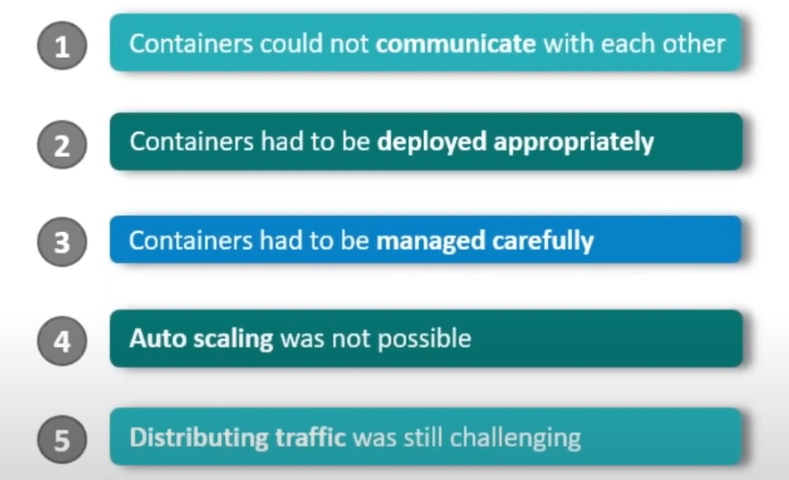
Problems With Scaling Up Container
Notes:
Solution for above is -
Kubernetes is a tool used to manage clusters of containerized applications. In computing, this process is often referred to as orchestration.
Kubernetes coordinates lots of micro services that together form a useful application.
Kubernetes automatically and perpetually monitors the cluster and makes adjustments to its components.
Kubernetes, or k8s for short, is a system for automating application deployment.
Modern applications are dispersed across clouds, virtual machines, and servers. Administering apps manually is no longer a viable option.
It helps manage containers that run the applications and ensures there is no downtime in a production environment.
For example, if a container goes down, another container automatically takes its place without the end-user ever noticing.

Slide 9
What is Kubernetes – As Container Orchestration Tool
Kubernetes is Open source container management tool.
It automates container deployment.
It automates container scaling and descaling.
It automates container load balancing.
It work with all public, private and hybrid cloud vendor.
Kubernetes can group no of containers into one logical unit for managing and deploying them easily in one server node.
Notes:
Kubernetes analyse traffic and load used by container and as when traffic reach the threshold it start scaling up the container.
Containerization is good and better than VM but when containers are scaled they still cannot meet the today requirement specially in ecommerce application
Kubernetes is best when demand is even more and so we use kubernetes as container management tool.
This is google developed open source product. And it is developed in Go Language.
Now google has donated this product to CNCF that is Cloud Native Computing Foundation.

Slide 10
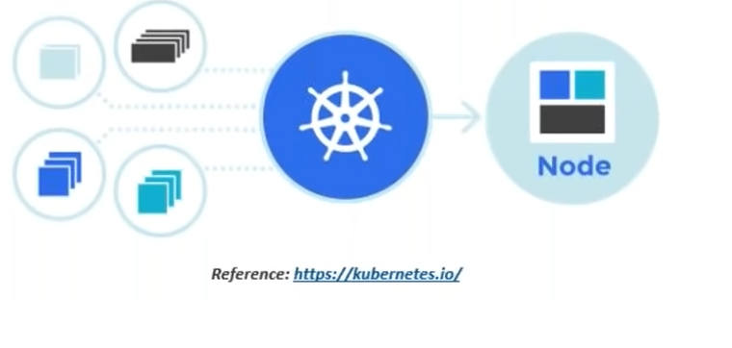
What is Kubernetes
Notes:
What is containerized application
-A containerize applications are app which runs in the container.
What is cloud native app
- Application that is designed to meet modern business demands like scaling, self healing ,rolling updates and can run on kubernetes.
What is miroservice App
-It is application that is built from lots of small specialized parts that communicate and form meaningful application.
Where did kubernetes come from
-Google
-Kubernetes and Docker are complementary technology.
-It is common to develop your application with Docker and use kubernetes to orchestrate them in the production.
Operating system of cloud
- We install traditional OS on server and OS abstract the physical server resources and schedule the processes.
-Like wise we install kubernetes on cloud and it abstract the cloud resources and schedule the various micro services of cloud –native application

Slide 11
Features of Kubernetes
Automatic Binpacking
Service Discovery & Load Balancing
Self Healing
Secrete and Configuration
Notes:
Automatic Binpacking - Kubernetes packages our application and automatically places a container based on requirement and resources available.
Service Discovery & Load Balancing - No need to worry about networking and communication since kubernetes automatically assigns the containers and its IP address and single DNS names for a set of containers which are performing logical operation.
Self Healing - When kubernetes realize that container is failed then it restart a container by its own. It creates a new container instead of crashed one. Incase even if node get failed, kubernetes will do that whatever containers was running in failed node it will get started in new node. Of course we will require more node created in the clusters
Secrete and Configuration - We can deploy and update our secrete and application configuration without having to rebuilding the entire image and without having to expose the secrete in the stack configuration.

Slide 12
Features of Kubernetes
Storage orchestration
Horizontal Scaling
Batch Execution
Automatic Rollback and Rollouts
Notes:
Storage orchestration- With kubernetes we can automatically mount our storage system of our choice. we can choose local storage, or storage on public cloud provide like GCP /AWS or network storage systems.
Horizontal Scaling- We can run simple command to easily scale up and down the application.
Batch Execution- Along with services, kubernetes can manage batch and save workload. More of with respect to Devops role.
Automatic Rollback and Rollouts- Whenever there is update in the application to be release, kubernetes progressively roll out the changes in the application ensuring that one instance after the other send this update . And it ensures high availability and if something goes wrong then it will rollback that change for you.

Slide 13
Features of Kubernetes
Robust and Reliable
Best solution for scaling up the container.
Container orchestration Platform
Backed By Huge Community

Slide 14
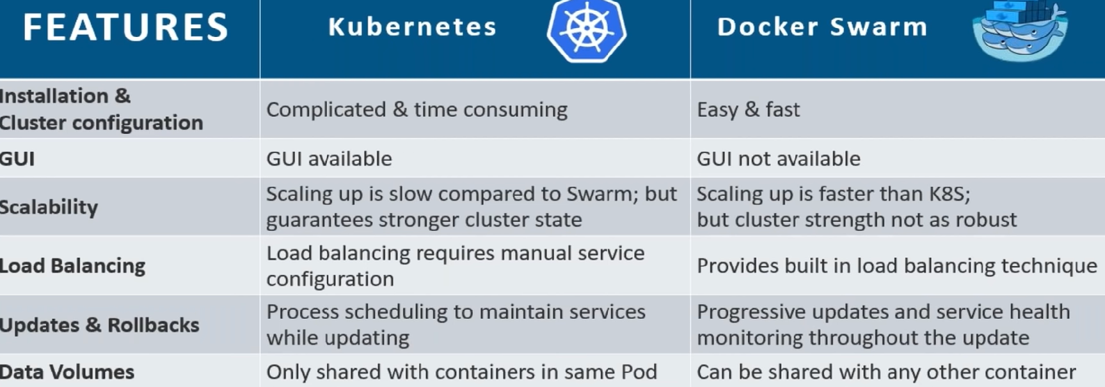
Kubernetes vs Docker Swarm

Slide 15
Summary
In this lesson, you have learned about:
Introduction of Kubernetes
Notes:
Add instructor notes here.

